Slide 1
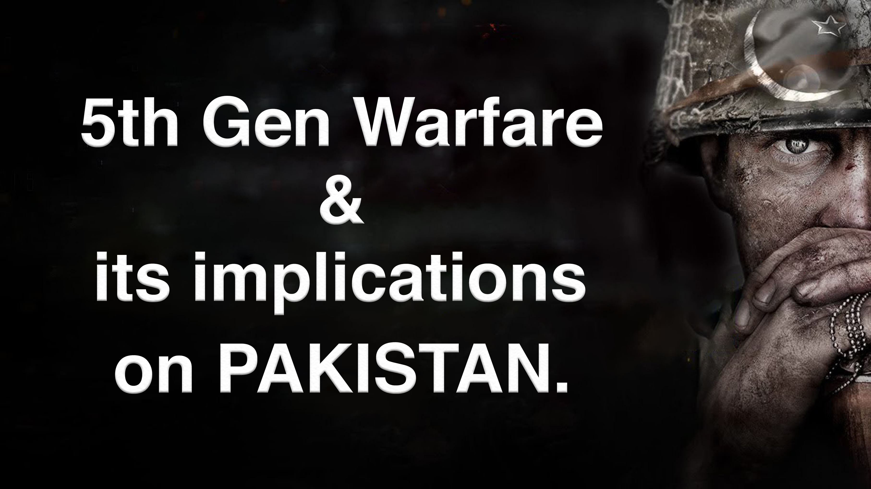

Slide 2
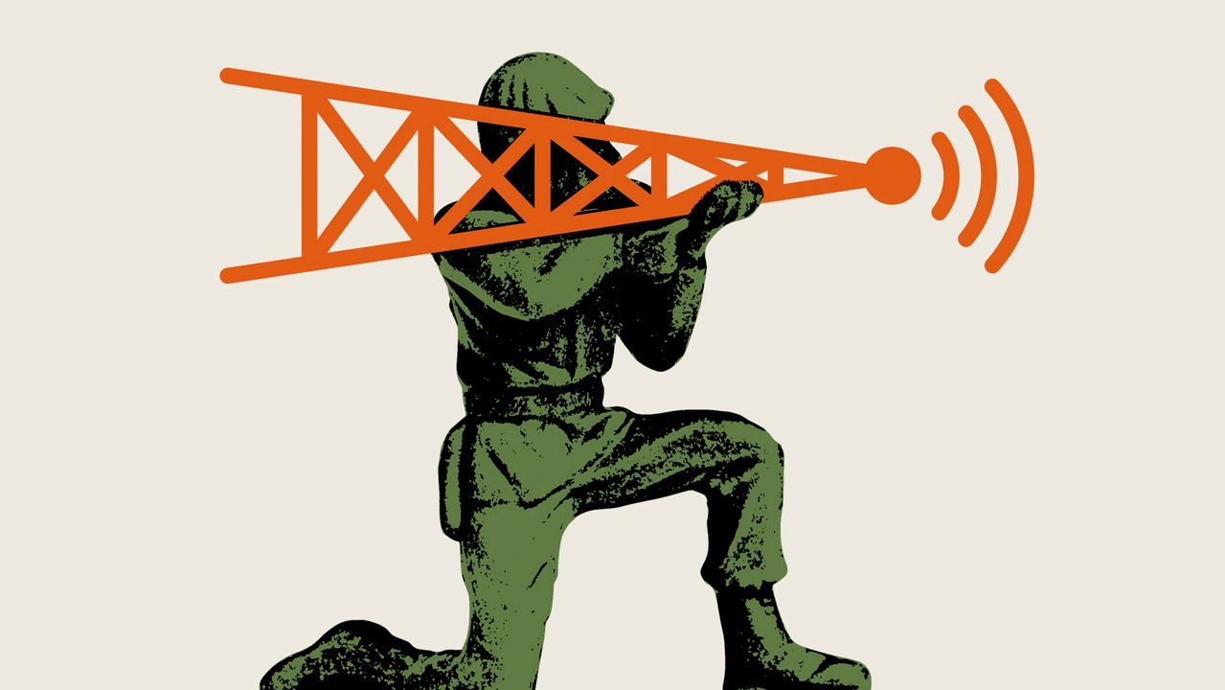

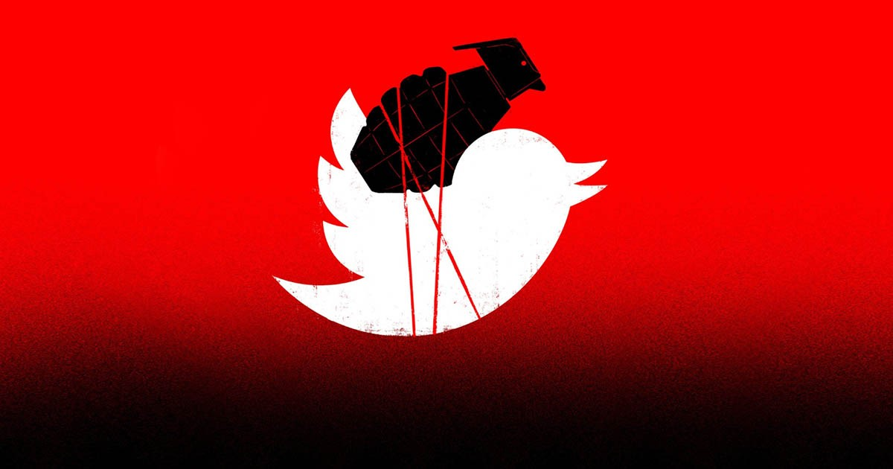
What is 5G Warfare?
War of Digital Medium
Fake News
Fake Websites
Targeted social Media campaigns

Slide 3
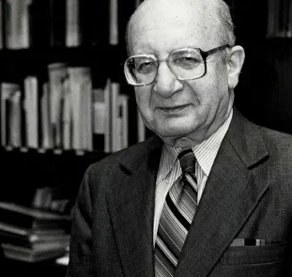
How it all began?
Participated in the UNHRC session in 2007 and 2011
Criticized Pakistan for its human rights abuses.
Had already died in 2006
THEN WHO PARTICIPATED IN THOSE EVENTS???
Prof. Louis B Sohn
Human Rights Activist

Slide 4

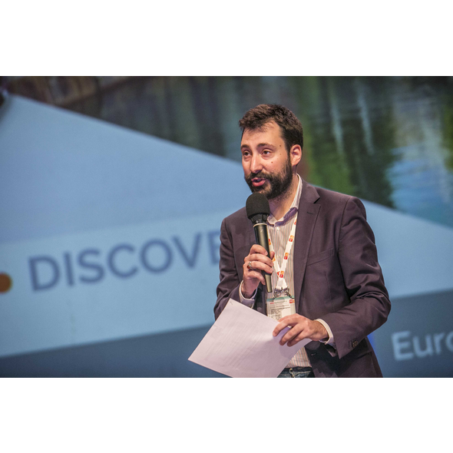
EU Dis-Information Lab
A watchdog which monitors and exposes global
Propaganda campaigns against targeted groups.
Started investigating Prof. Louis B Sohn’s resurrection.
Published the report “Indian Chronicles” in Dec 2020.
Exposed a propaganda network working for the past
15 years.
Alexandre Alaphilippe
Executive Director of Eu Dis-info Lab

Slide 5
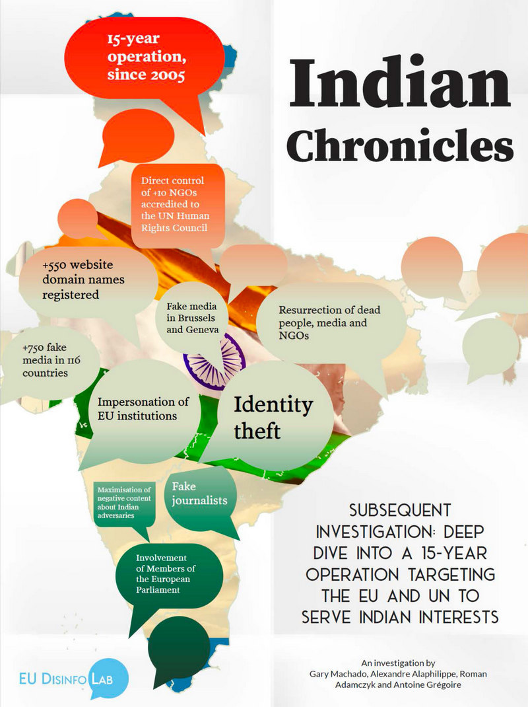
THE INDIAN CHRONICLES, 2020
Fake Media in Brussels
and Geneva
550+ Domain fake
names registered
All with one single GOAL,
“TO DISCREDIT PAKISTAN”.
Identity Theft
Resurrection of dead
people and NGOs

Slide 6
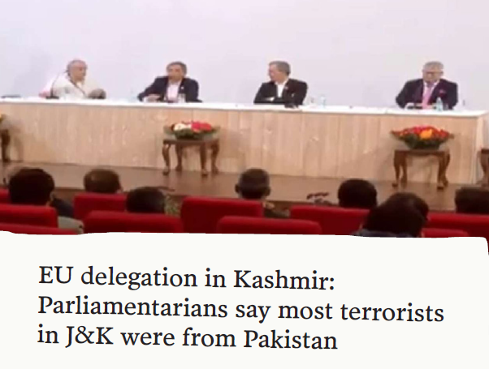
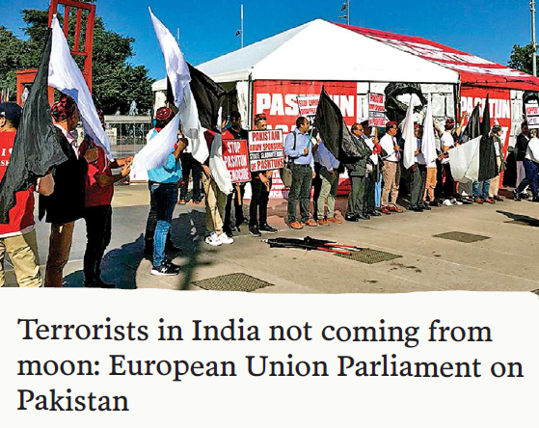
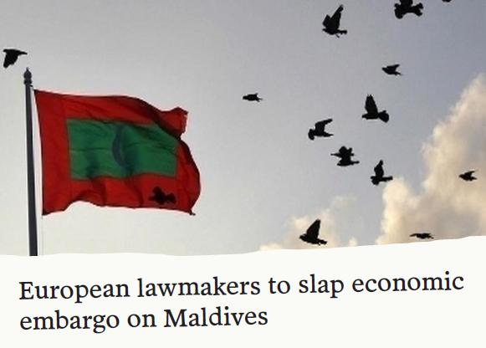
LOBBYING IN BRUSSELS (EU Head Office)
Fake media outlets reported Private trips as official visits of European Members of Parliament
and miss-quoted statements.
Reported by: DNA Media Group
FACT: Not an official delegation
Reported by: DNA Media Group
FACT : Statement by a Single MEP
Reported by: ANI Media Group
FACT : Henri Malosse exaggerating
his authority.

Slide 7
THAT’S NOT ALL…. A BIG/COPY PASTE NETWORK
THE ROLE OF ANI NEWS AGENCY: REPACKAGING AND AMPLIFYING CONTENT PRODUCED
IN BRUSSELS AND GENEVA
ANI owned about 450 ‘self-proclaimed’ news outlets which basically copy-pasted the content
generated with the help of Fake NGOs in UN (Geneva) and EU Parliament (Brussels).

Slide 8

SRIVASTAVA GROUP: The culprit pulling strings behind the curtain
A Delhi based business group founded
by G N Srivastava
During investigations EU Disinfo-Lab found an intriguing
connection between Srivastava Group the NGOs
which were involved in discrediting Pakistan
European Union Parliament (Brussels) and United Nations
(Geneva)

Slide 9
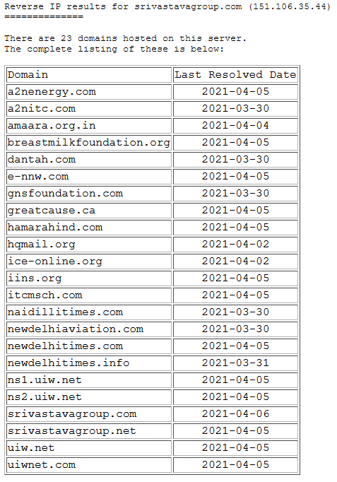
The WEAK LINK
Eu Dis-info found the websites of several EU-accredited
NGOs were hosted on the same servers upon which the
websites of Srivastava group were stored.
After the publication of “Indian Chronicles” report most of
the websites were down and haven’t come online till
date.

Slide 10
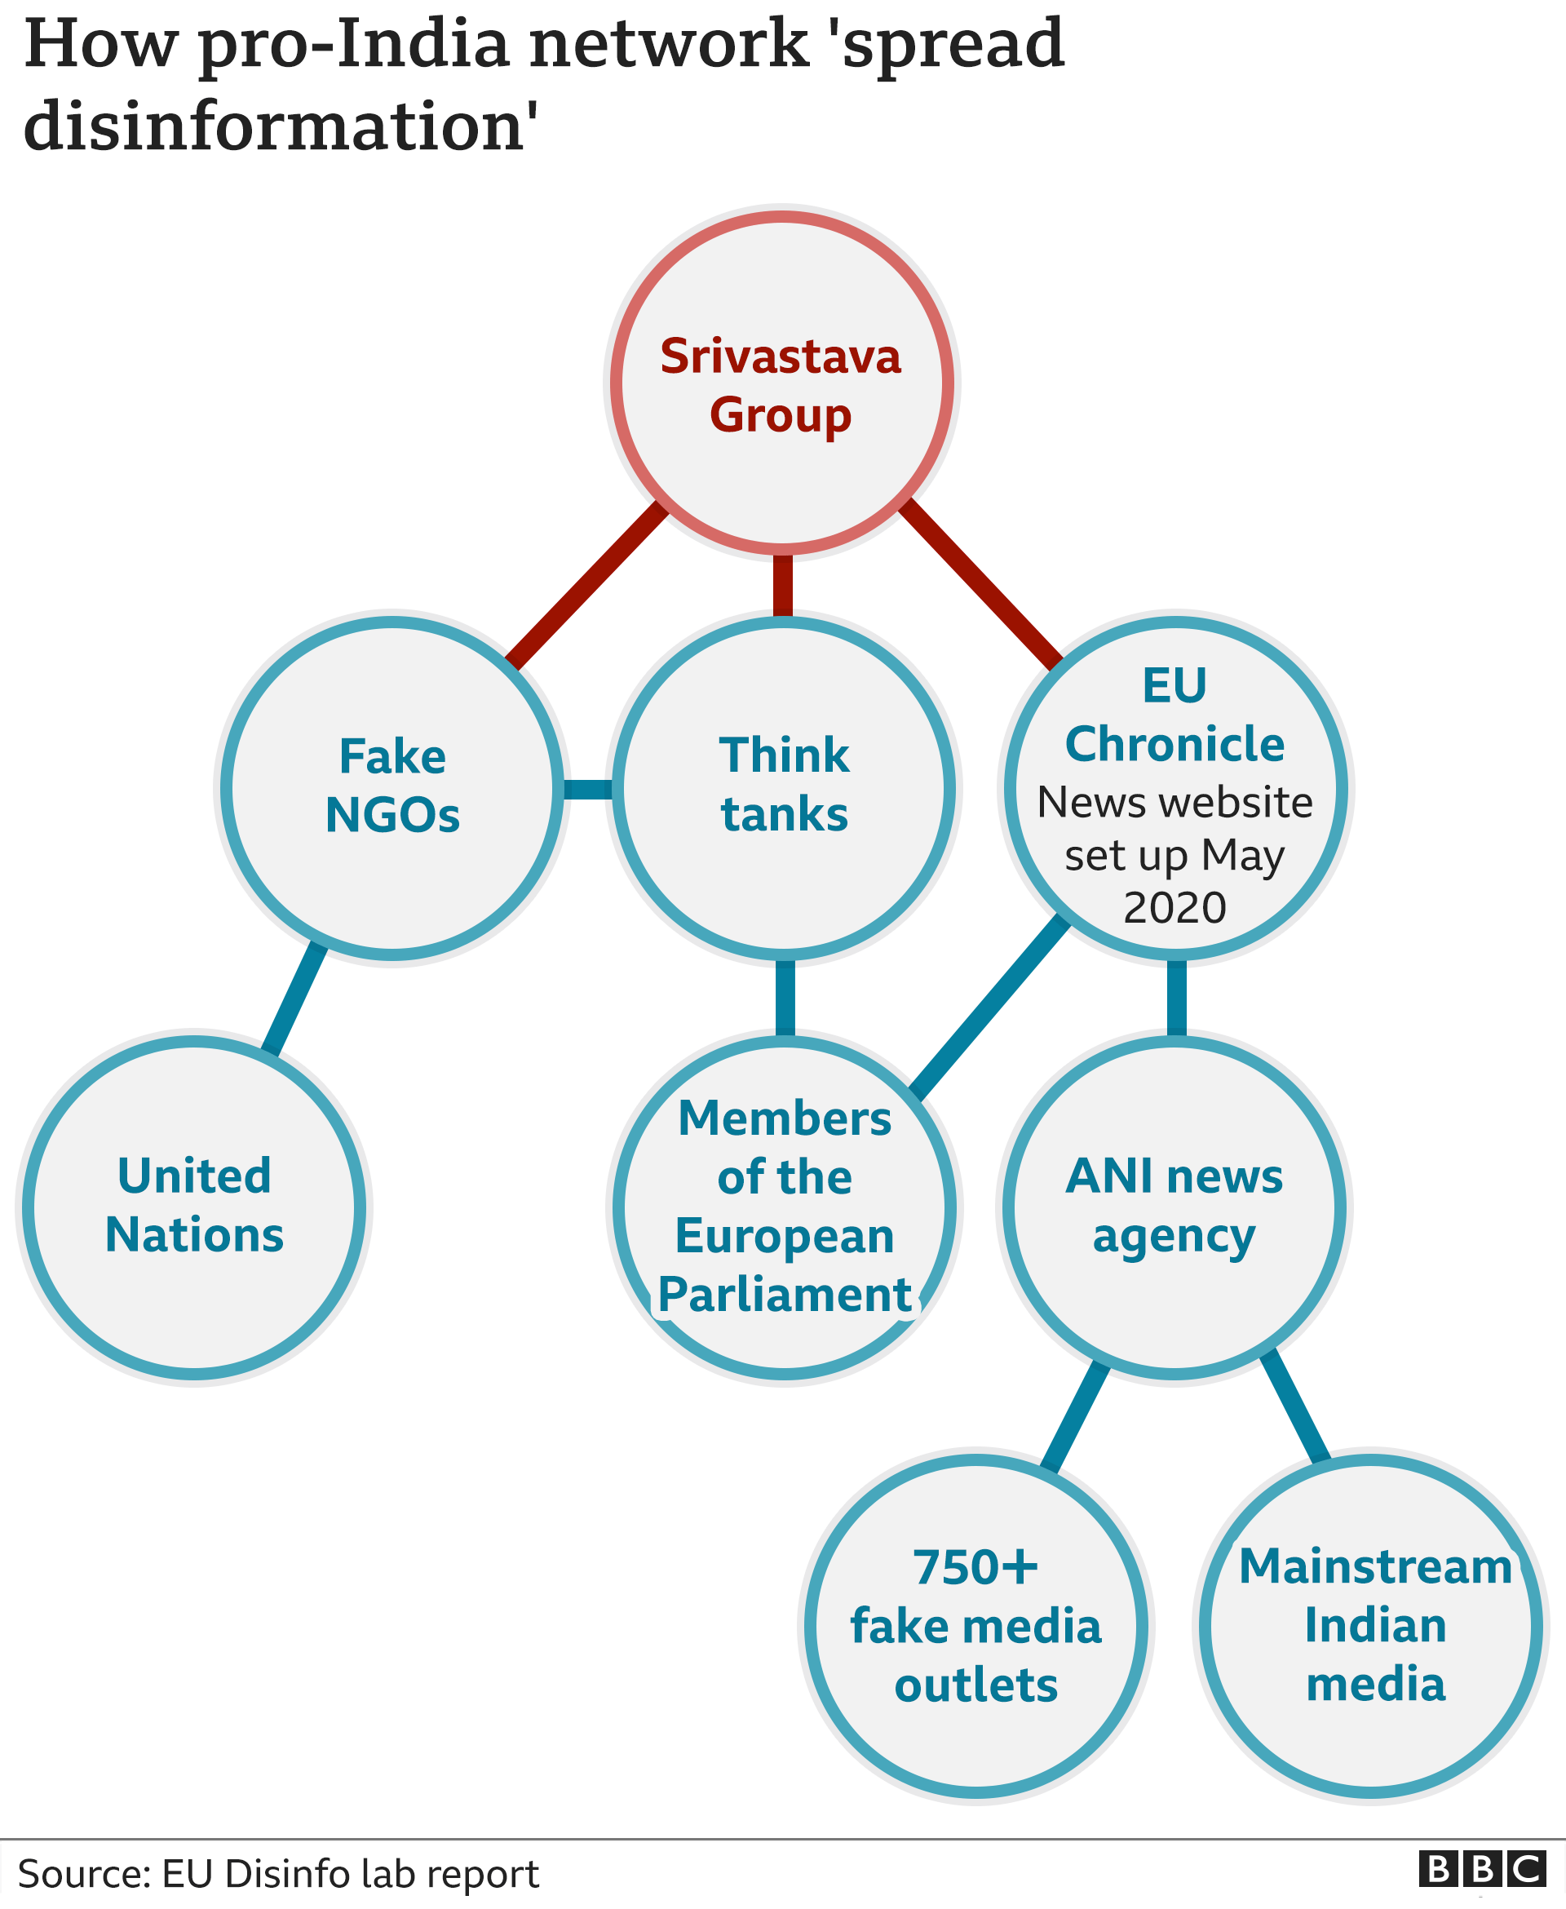
A DEEPER LOOK…
EU Dis-info Lab investigated an NGO, International
Club for Peace Research(ICPR) which had ceased to exist
in 2004.
But, In 2009 ICPR reappeared at the United Nations
Human Rights Council, this time its website was tied to the
gmail account icpr.eu@gmail.com whose bank accounts
details were directly linked to, “ANKIT SRIVASTAVA” (OWNER OF
SRIVASTAVA GROUP).
But that was only the tip of the ice berg!

Slide 11
FAKE NETWORK OF NGOs in EU AND UN
EU Dis-info Lab found out 10 UN accredited NGOs directly controlled by
Srivastva Group.
All 10 NGOs had the following traits in common:
They were resurrected from the ashes of real NGOs.
Discredited Pakistan in the UN and EU and promoted Indian interests
in UN meetings regarding important matters.

Slide 12
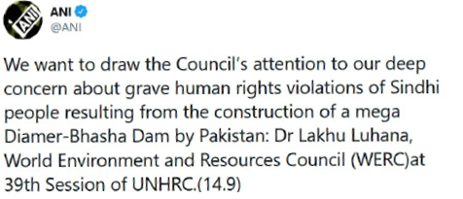
CASE STUDY I
World Environment and Resources Council(WERC):
Founded in 1970s to promote, “Sciences of
Environmental importance”.
Ceased to exist in late 90s.
Hijacked by Indian chronicles in 2005 and
representatives from this NGO participated
in UN sessions.
Did false propaganda on Baloch and
Sindhi genocide and discredited Pakistan
on the international stage.
ANI News Agency spreading the
propaganda of fake NGOs.

Slide 13
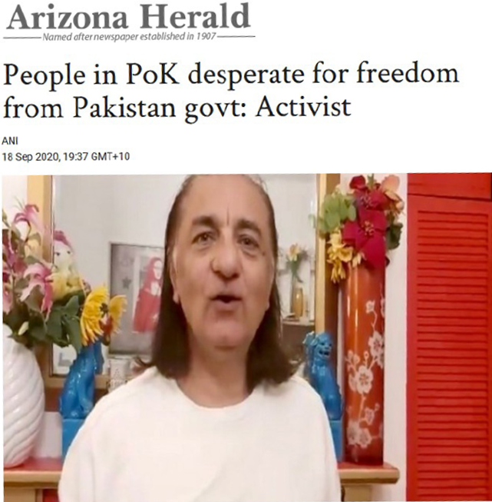
CASE STUDY II
CENTER FOR ENVIRONMENTAL AND MANAGEMENT STUDIES(CEMS) :
Originally formed in New Delhi in 1980s.
Stopped its activities in 1986.
Emerged again on the international stage in
Jan, 2016 this time hosted under the same network
of NGOs whose IP addresses were owned
by Srivastva group.
Headed by “Amjab Ayb Mirza”.
Propagated Indian stance on Kashmir issue
and accused Pakistan of terror financing
in Kashmir.
Arizona Herald: another media
outlet owned by Srivastva group

Slide 14
PAKISTAN’S RESPONSE
Pakistan had long been demanding the international community to take notice of
Indian State sponsored effort to de-stabilize the Northern and Balochistan region
of the country.
EU Chronicles further strengthened Pakistan’s stance on the international stage.
On Nov 14th, 2020 Pakistan’s Foreign Minister and DG ISPR held a press conference and
released a dossier for the international community containing evidence of the Indian
State Sponsored terrorism and hybrid war being waged against Pakistan.

Slide 15
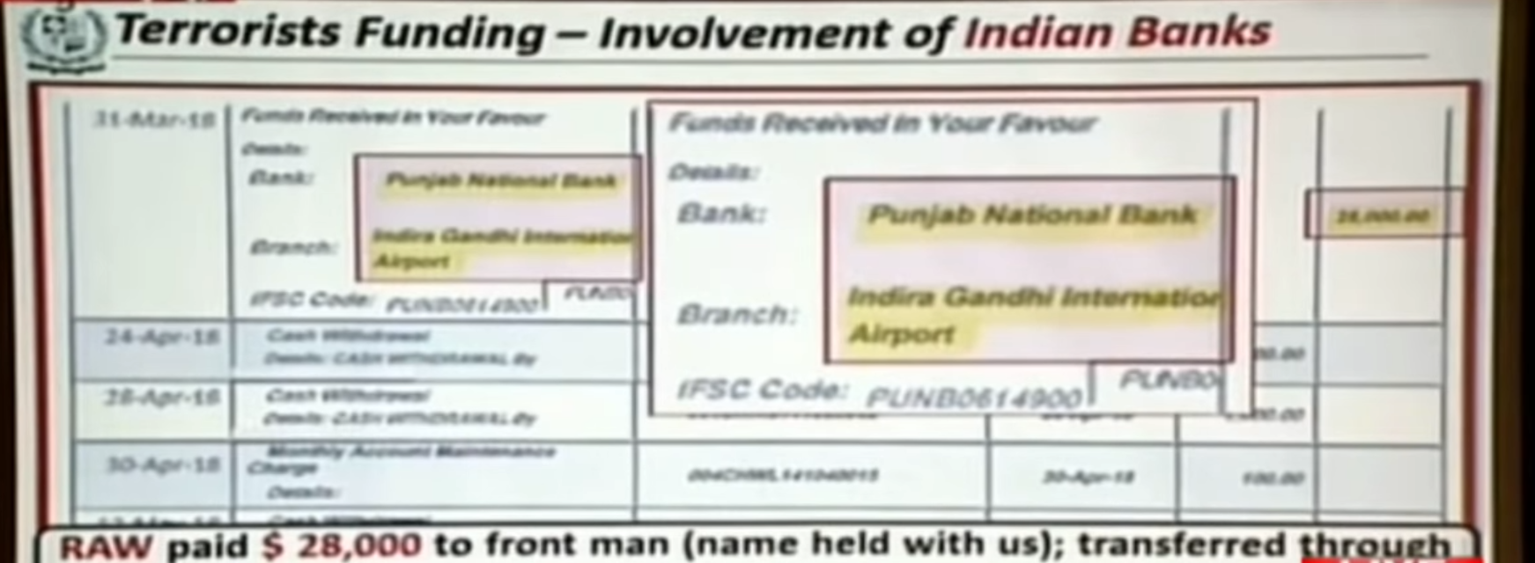
PAK FM Shah Mehmood and DG ISPR’s Press Conference
The Foreign Minister highlighted how Indian Consulate offices adjacent to Pak’s border
in Afghanistan were actively working to de-stabilize the southern region of the country.
The Minister told the press how Indian was pouring money in Afghanistan to fund ethnic
militias which would in turn attack Pakistan.
Intelligence proof: Bank receipt of money
transferred from Indian banks and received by
Indian consulate in Pakistan.

Slide 16
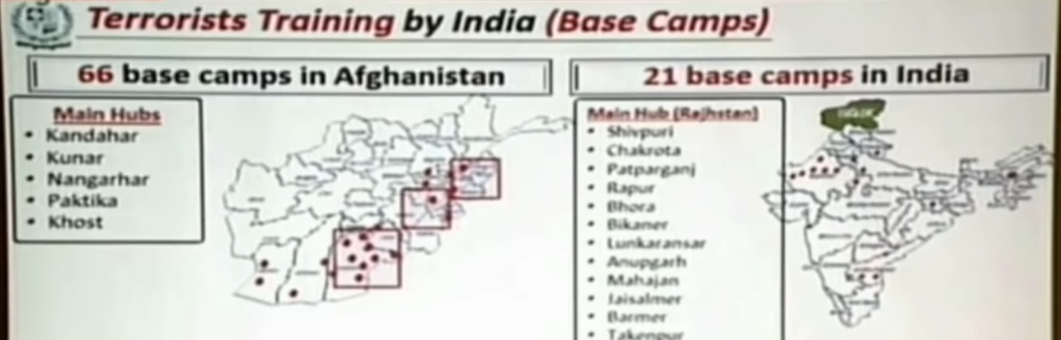
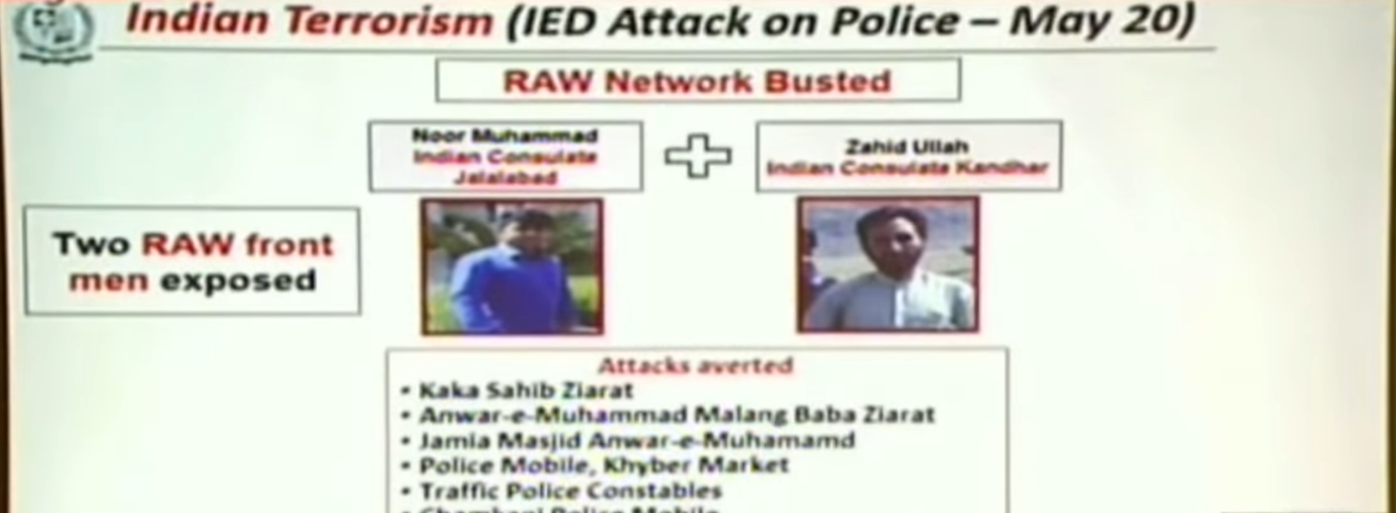
Terrorists launch pads in Afghanistan
The Foreign Minister also highlighted the
location of terrorist camps along the
borders of Afghanistan and India.
Where terrorists were being trained and
infiltrating Pakistan through the Afghan
border.
In Intelligence based operations a number of
Afghan nationals were also captured who were
working as the front-men of the Indian
Intelligence agency (RAW). During investigations
they admitted to be involved in a PC Hotel
attack (2016) and Peshawar University
attack (2017).

Slide 17
What’s next?
As responsible citizens of Pakistan we can take the following steps
to counter this hybrid warfare:
Keep ourselves informed with current affairs of Pakistan.
Counter Fake news and propaganda with Facts and Figures.
PAKISTAN ZINDABAD!

Slide 18
THAT’S ALL FOLKS!
Contributors:
Bilal Ahmed Khan
MUhammad Wamiq Akram
Muhammad Kamran
Ahmed Ahsan
Zulnoor Siddiqui

